Slide 1
RAID MODELS
Redundancy: Duplicating data across multiple disks. Ensures availability even if one disk fails
FROM BSAI GROUP B, BY MUHAMMAD HAMMAD SHAKEEL , hammad hussain , syed-hissam-ul-mulk for ICT theory
(Redundant Array of Independent Disks)
(Redundant Array of Inexpensive Disks)

Slide 2
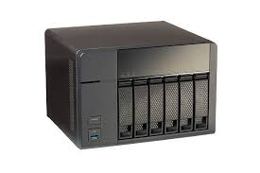
storage virtualization technology:
It enables users and systems to interact with storage as a centralized resource, hiding the complexity of the underlying hardware.
Introduction to RAID
Combines multiple physical disks into one logical unit.
Enhances performance, reliability, or both..

Slide 3
BENEFITS
Can help prevent data loss by Providing redundancy
Increases Storage capacity
Improves read/write performance.

Slide 4
Key RAID Concepts
Striping: Distributes data across multiple disks to improve performance.
Mirroring: Copies identical data onto two or more disks for redundancy.
Parity: Stores error-correcting information to recover data in case of failure.

Slide 5
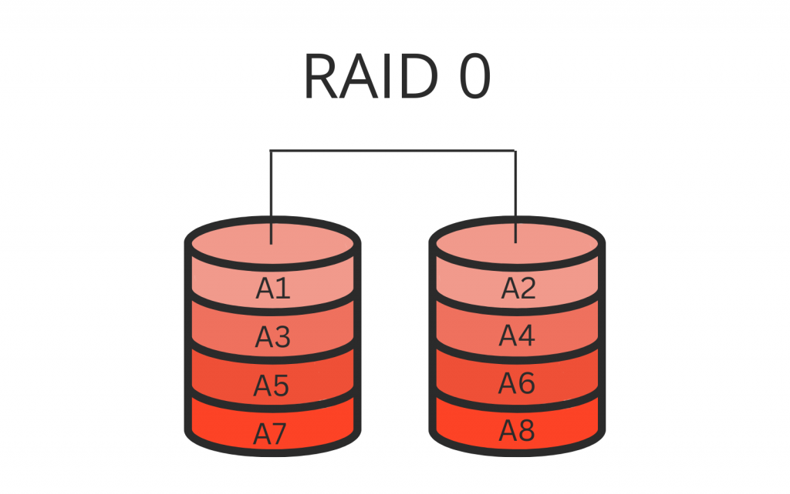
STRIPING
High performance, no redundancy.
Ideal for systems needing speed.
Block level data division
Disk 1
Disk 2

Slide 6
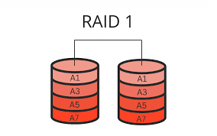
Mirroring
High redundancy, lower storage
efficiency.
Best for critical systems requiring
data protection
Lower performance compared to
Raid 0
Disk 1
Disk 2

Slide 7
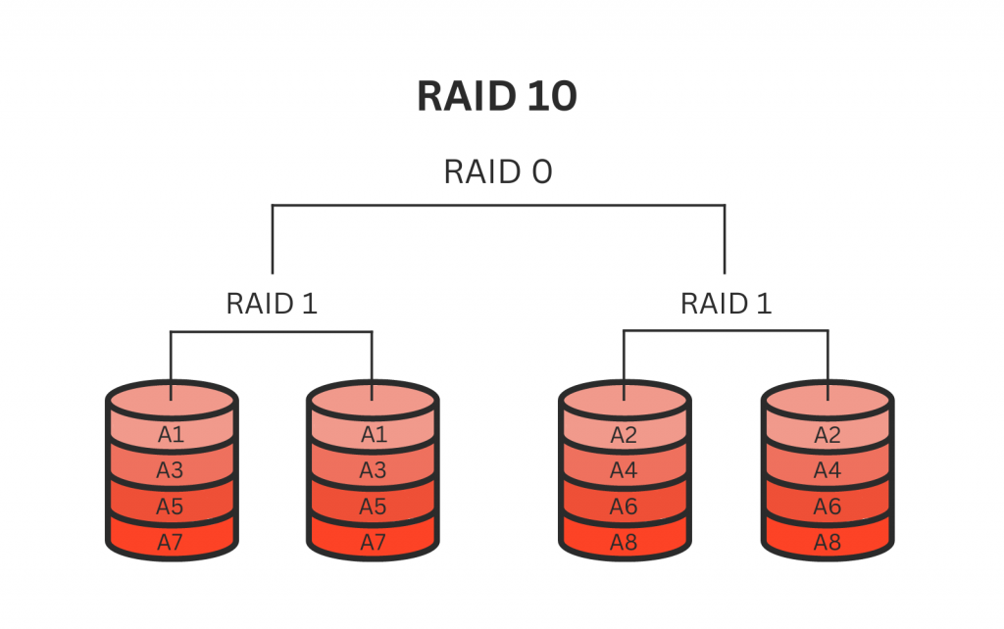
Nested Raid 10 (1+0)
Combines striping and mirroring.
High performance and redundancy.

Slide 8
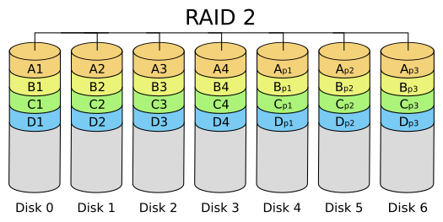
RAID 2
Parity with data Striping at bit level
Use hamming code and error correction code
expensive

Slide 9
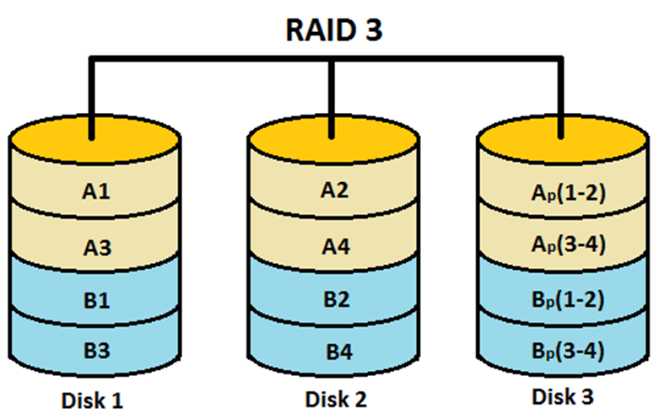
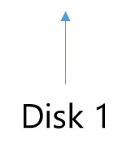
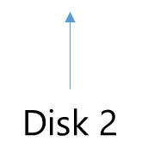

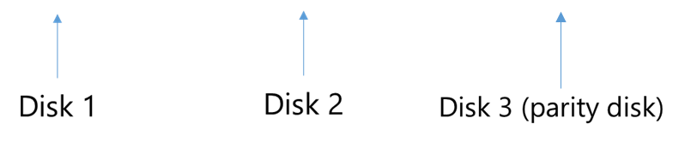
Parity
Parity with data Striping at byte level
0 | XOR | 0 | = | 0
1 | XOR | 1 | = | 0
1 | XOR | 0 | = | 1
0 | = | 0 | XOR | 0
1 | = | 1 | XOR | 0
1 | = | 0 | XOR | 1
Disk 1
Disk 2
Disk 3 (parity disk)

Slide 10
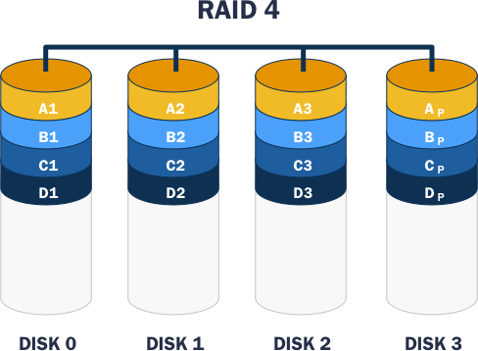
Parity disk speed bottleneck
Same Parity mechanism with data Striping at block level
Minimum 3 disks

Slide 11
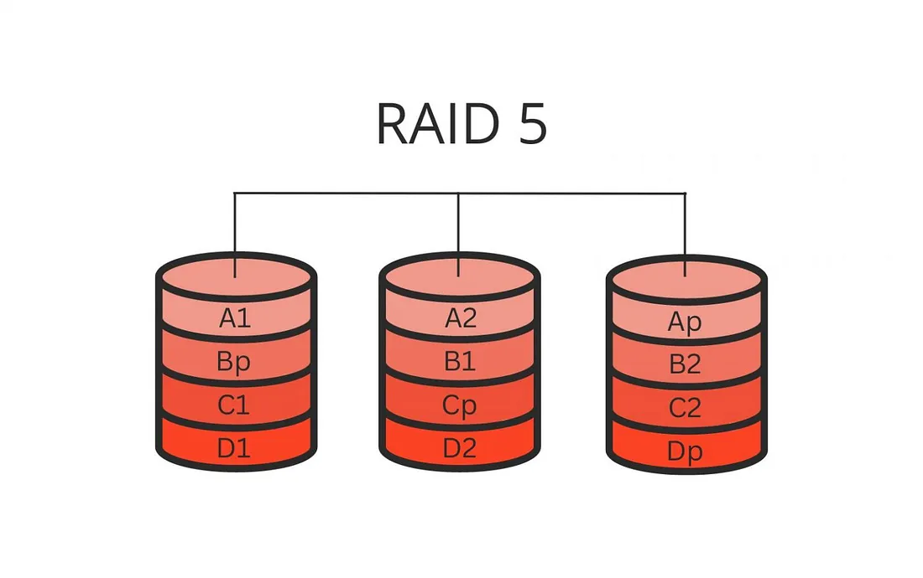
RAID 5 (Striping with Parity):
Balanced performance and fault tolerance.
Requires at least three disks

Slide 12
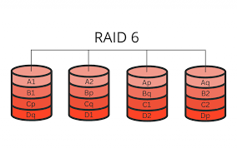
RAID 6 (Striping with Double Parity):
Can withstand two disk failures.
Suitable for high-availability systems.
Minimum 5 disks

Slide 13
Conclusion
Data centers and cloud storage providers. GOOGLE
Critical systems like financial services and healthcare.
Multimedia production and content delivery networks.
Network-Attached Storage (NAS).
High-performance computing.
RAID provide reliable data protection
Increased read/write performance

Slide 14

link link2 link3 link4 Thank you Everyone

